Slide 1
E-gov
Imran Mahmud

Slide 2
Definition
The concept of electronic government (eGov), sometimes electronic governance, is about to emerge from a practitioners’ concept to one that also attracts research. eGov generally refers certainly to more use of IT, but more importantly to attempts to achieve more strategic use of IT in the public sector.
E-government is also known by different terms such as Electronic Government, Electronic Governance, Digital Government, Online Government, E-gov.
World Bank, (2001) define E-government as the government owned or operated systems of information and communication technologies that transform relations with citizens, the private sector and/or other government agencies so as to promote citizens’ empowerment, improve service delivery, strengthen accountability, increase transparency, or improve government efficiency

Slide 3
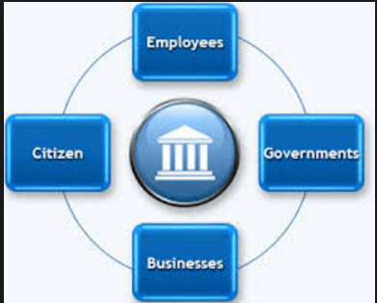
Types of E-gov
G2C
G2B
G2G
G2E

Slide 4
G2C
The majority of government services come under this application, towards providing citizens and others with comprehensive electronic resources to respond to individuals’ routine concerns and government transactions.
Government and citizens will continuously communicate when implementing e-government, thus supporting accountability, democracy and improvements to public services.

Slide 5
G2C
a2i , Access to Information
http://a2i.pmo.gov.bd/innovation-lab/lab/service-innovation-fund/government-to-citizen-services/

Slide 6
Existing Projects
উত্তরাধিকার ক্যালকুলেটর
নথি
অনলাইনে পাসপোর্টের আবেদন
অনলাইনে সেবার আবেদন
অনলাইন চালান যাচাইকরণ
ভিসা যাচাই
জন্ম ও মৃত্যু নিবন্ধন
অনলাইন আয়কর পরিশোধ
জাতীয় পরিচয়পত্রের তথ্য হালনাগাদকরণ

Slide 7
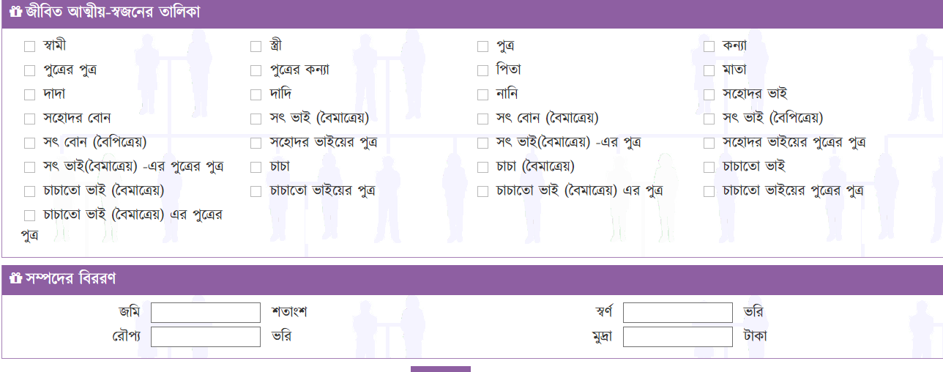
http://উত্তরাধিকার.বাংলা

Slide 8
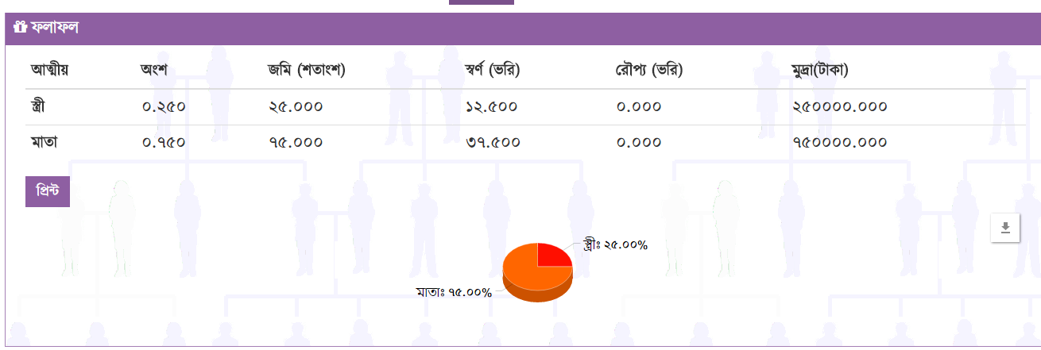

Slide 9
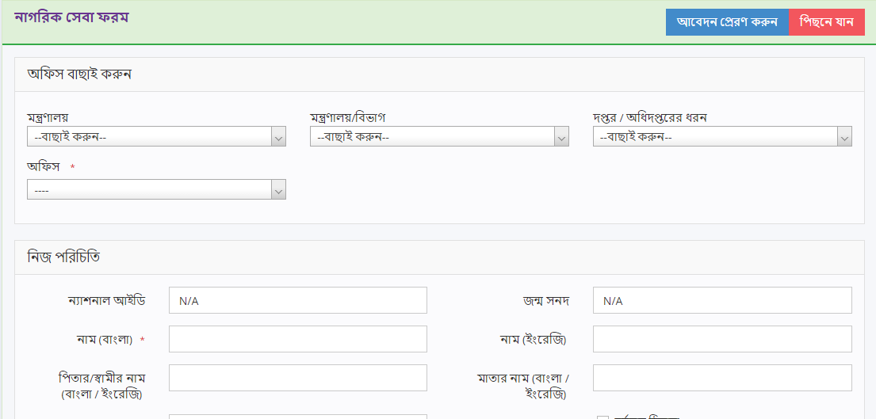
http://www.nothi.gov.bd/dak_nagoriks/OnlineAbedon

Slide 10
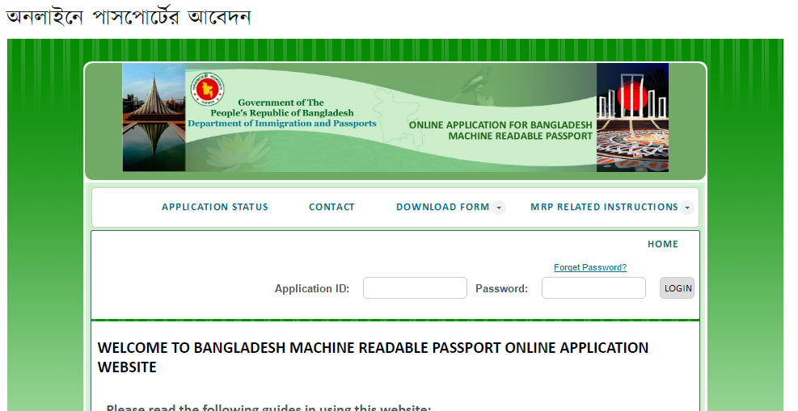
http://www.dip.gov.bd/site/page/f2d015a9-1132-4426-8eef-147f1c4bac8a

Slide 11
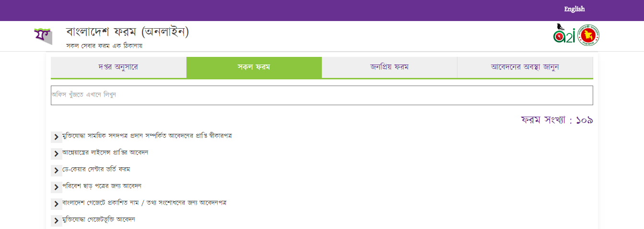
http://online.forms.gov.bd

Slide 12
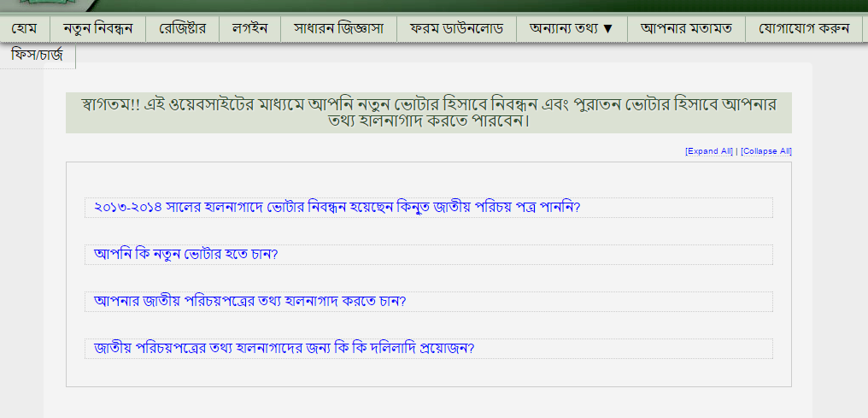
https://services.nidw.gov.bd

Slide 13
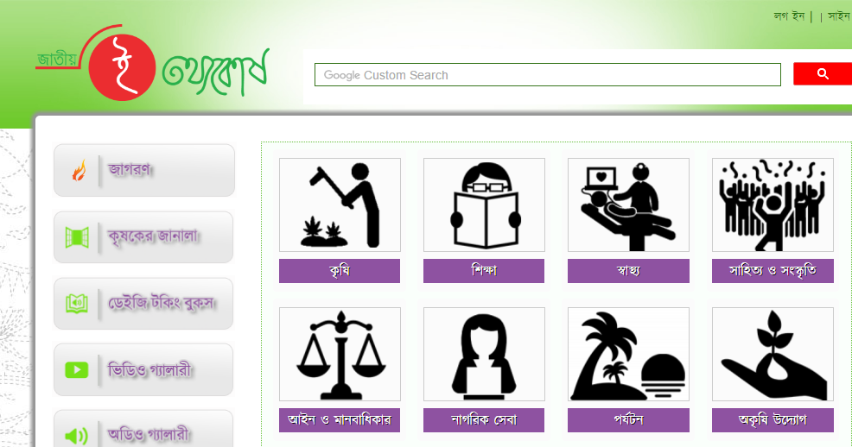
http://www.infokosh.gov.bd

Slide 14
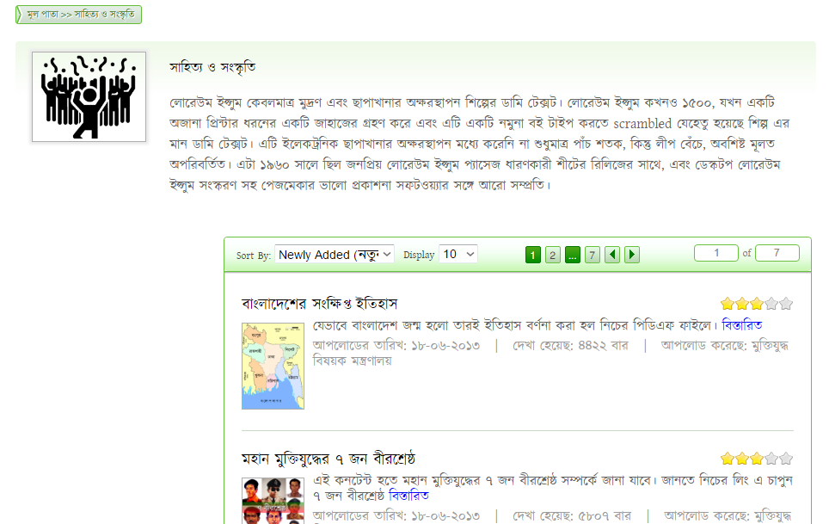

Slide 15
Other existing projects
Education
Multimedia classroom
Teacher portal
Agriculture
Digitally completion and standardization of Plants Problems Identification System (DPPIS)
Online Fertilizer Recommendation: Automation of data processing and data updating

Slide 16
Health
Ma o Shishu
Disability
Multimedia talking book (DAISY MULTIMEDIA TALKING BOOK)
Land
LISF (Land Information and Service Framework)
One Stop Service in the Land Office to Solve Land Disposal

Slide 17
Law
Increasing the Activity of Women Prevention Cell
E mobile court
Environment
Online Environment Clearance Certificate

Slide 18
Ongoing projects
Multimodal transport web portal: A web portal where the citizens will have access to all the necessary details of the multimodal transportation services in Bangladesh including details of ticket pricing, transport quality, nearest booths and routes.
Maintenance of Ordinary Account of postal savings bank using smart card: Introduction of postal cash card using mobile with GPRS connectivity and connected with central server.
Prototyping a cell phone tour for museums that will enrich the learning experience of public: A cell phone tour containing text, audio, visual image, music, etc. of museums and cultural heritage sites which are downloadable and usable in offline mode benefitting scholars, teachers, students and general people.

Slide 19
Smart Holding Assessment and Tax Management System
SMS-based Jute Purchase and Sales
Mobile app for Bangladesh Public Service Commission Exams
Electronic Driver License Issue
Property Management System of Narayanganj City Corporation
Automation of data processing and data updating in Online Fertilizer Recommendation System
Mobile application for Emergency Services

Slide 20
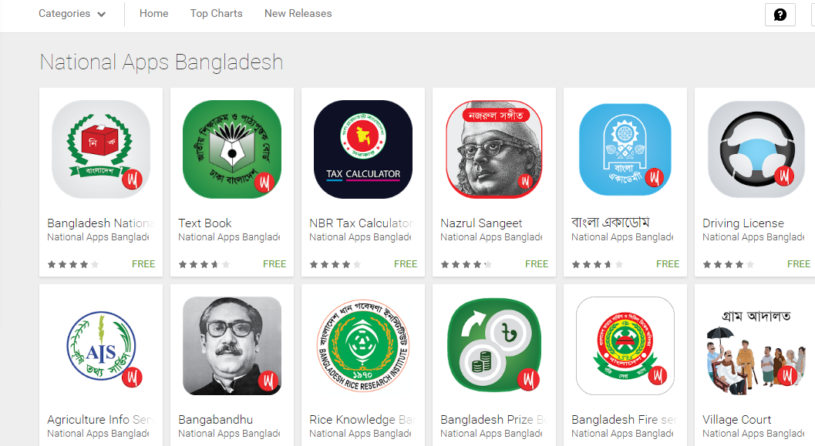

Slide 21
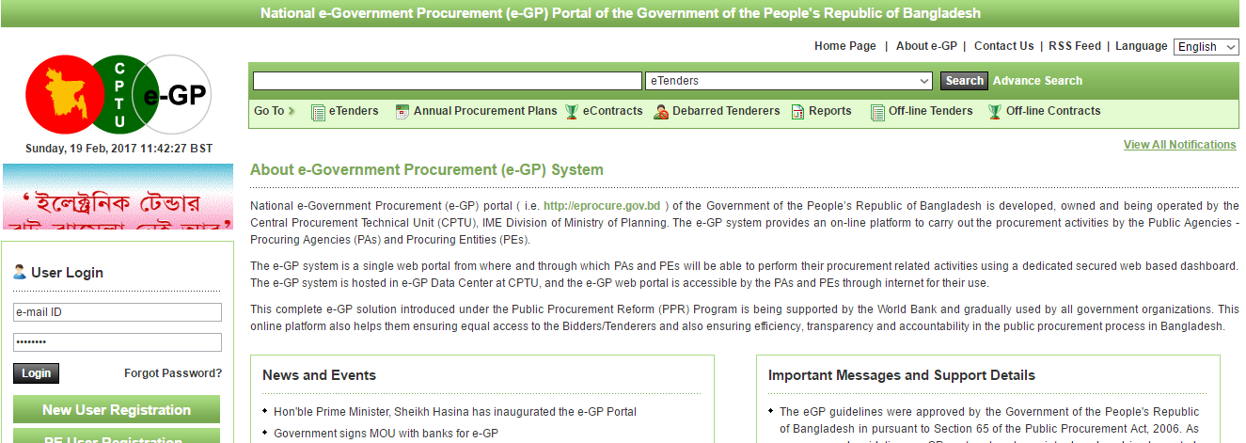
https://www.eprocure.gov.bd (G2B)

Slide 22
Additional
http://www.a2i.pmo.gov.bd/wp-content/uploads/2016/08/a2i_Success_Story_Book-2010.pdf?autoplay=1

